Slide 1



HOTEL BOOKING DATA
ANALYSIS
Hotel Booking Trends and Customer Insights
Design By :- Nishant Nimbalkar
Guided By :- Abhishek Wavhal

Slide 2
Table of Contents
1. Project Summary
2. Project Overview
3. About the Data
4. Problem Statement
5. Data Preparation
6. Expected Outcomes
7. Data Cleaning
8. Data Visualization
9. Key Findings (Most preferred hotel, Most cancellations, Peak month)
10.Conclusion

Slide 3
SUMMARY
To understand how City Hotel and Resort Hotel performed in 3 years (2015-2017), we studied their business in detail. In this analysis, we looked at how well they worked, how satisfied their customers were, their position in the market, their financial results, and how many rooms they sold. We also reviewed their sales, along with their long-term strategies.
The main goal of this study is to find useful insights that can help both hotels improve their services, earn more profit, and grow in a better and sustainable way.

Slide 4

Project Overview
Scope: Includes booking, guest, and reservation data for City Hotel and Resort Hotel.
Tools Used: Power BI (Dashboard Creation), Excel(Initial Data Cleaning), Power Query (Data Transformation).
Deliverables: Dashboard, Insights, Recommendations.

Slide 5

About the Data
Analyze 2015 Hotel booking Data to uncover patterns, Customer behavior, and operational insights across two types: City Hotel and Resort Hotel.
Data Overview:
Source Hotel Bookings (1).csv
Hotel Type: 1.City Hotel, 2.Resort Hotel.
Key Columns: Booking ID, Hotel, Arrival Date, Adults, Children, Babies, Stay Duration, Reservation Status, Market Segment, Customer Type, Meal, Country.
Data Size: Covers 175 countries, 5 meal types, and 75.20K total guests.

Slide 6
Problem Statement
Business Questions:
Which hotel type do guests prefer the most?
Which hotel has the highest cancellations?
Which month has the most guests?
Goal: Provide insights that help improve booking strategies and reduce cancellations.

Slide 7
Data Preparation
Data Preparation steps:
Imported raw dataset into Power BI.
2) Created calculated columns: Booking_ID, total_night_stays and total_persons.
4) Merged 3 Coumns (adults, Children, Babies) into new column name as (Total_Persons).
5) Combined weekend and week nights for total stay duration in New Column Name as total_Night_Stays .
6) Merged 3 Columns (arrival_date_day_of_month + arrival_date_month + arrival_date_year) into new Column name as Arrival_Date & Change Data Type(Text to Date).
7) Built relationships between tables.

Slide 8

Expected Outcomes
Expected Outcomes:
Increase Resort Hotel occupancy by 10% through targeted offers.
Reduce cancellations by improving prepayment or discount structure.
Use seasonal data for better staffing and pricing.

Slide 9
Data Cleaning
Actions Performed:
Create a Primary Key (Booking ID) to uniquely identify each record in table.
Fixed incorrect data types (text to numbers).
Delete (Company) column, Lot of NULL records(82133) & Delete column (Day_in_waiting_list) because it haves lots of 0 records (86365) & also remove Column (arrival_date_of_week_number) No Need .
Converted columns to correct data types.
Removed duplicates, Errors and missing values

Slide 10
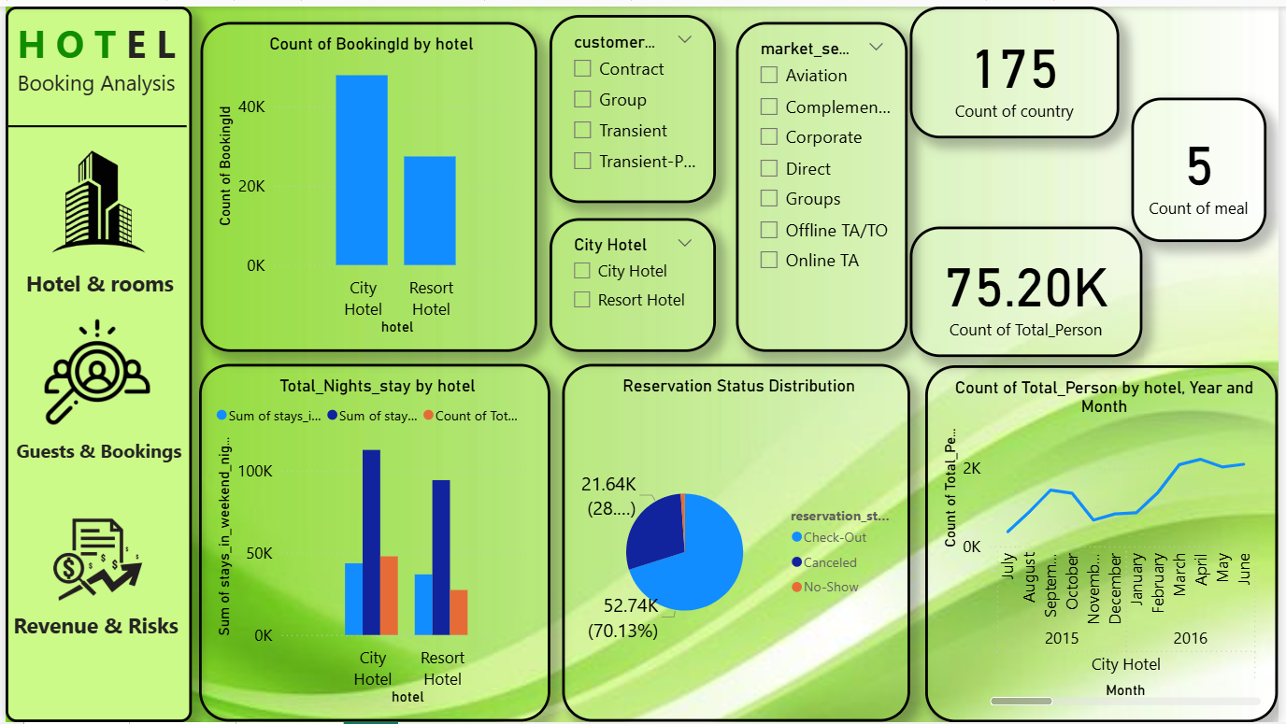
Data Visualization
Visuals Added:
Count of BookingID by Hotel.
Total Nights Stay by Hotel.
Reservation Status Distribution.
Total Persons by Hotel.
KPI Cards (Countries, Meals,
Total Persons)

Slide 11
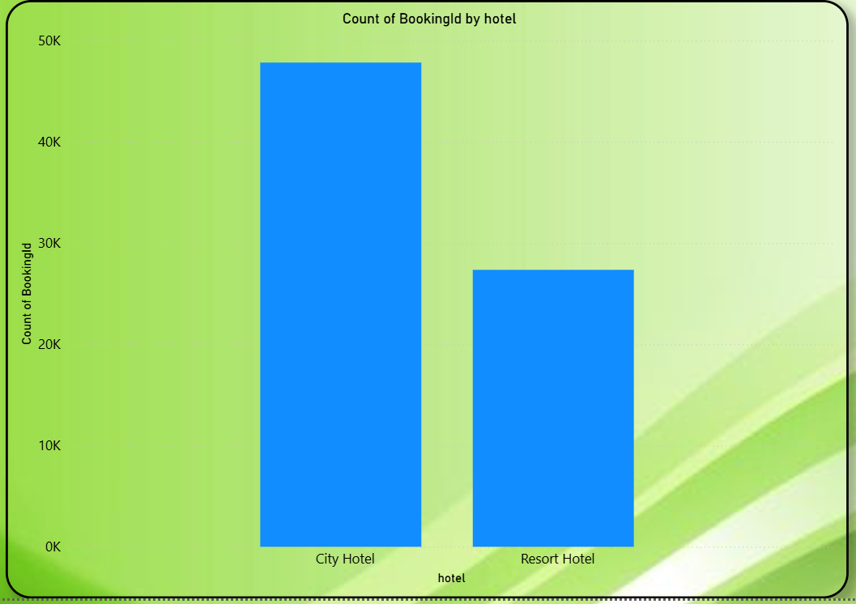
Most Prefered Hotel to Stay
Visual : Count of Booking ID by Hotel (Bar Chart)
Insight: City Hotel has the highest number of bookings — around 45K compared to 30K for Resort Hotel.
Conclusion: Guests prefer City Hotel due to convenience, urban access, and shorter stays.

Slide 12
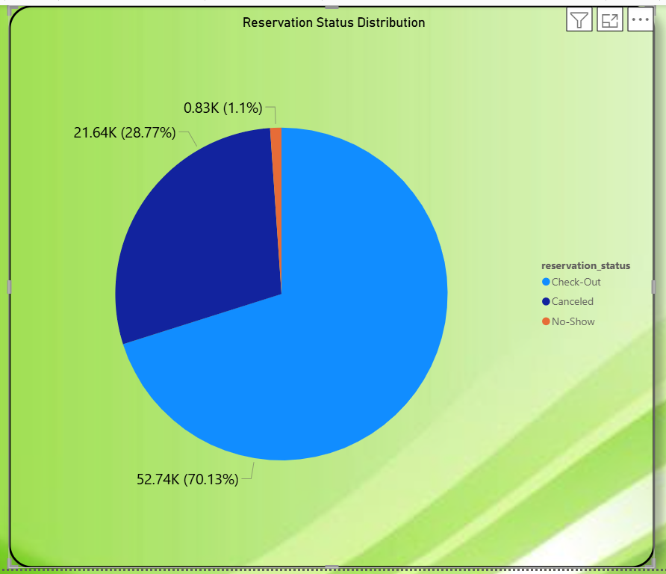
Most Cancellations by Hotel
Visual: Reservation Status Distribution (Pie Chart)
Insight: Resort Hotel has a slightly higher cancellation rate compared to City Hotel.
Breakdown: Check-Out — 52.74K (70.13%), Canceled — 21.64K (28%), No-Show — small portion.
Conclusion: Resort bookings are more likely to cancel, possibly due to seasonal travel and longer planning time.

Slide 13
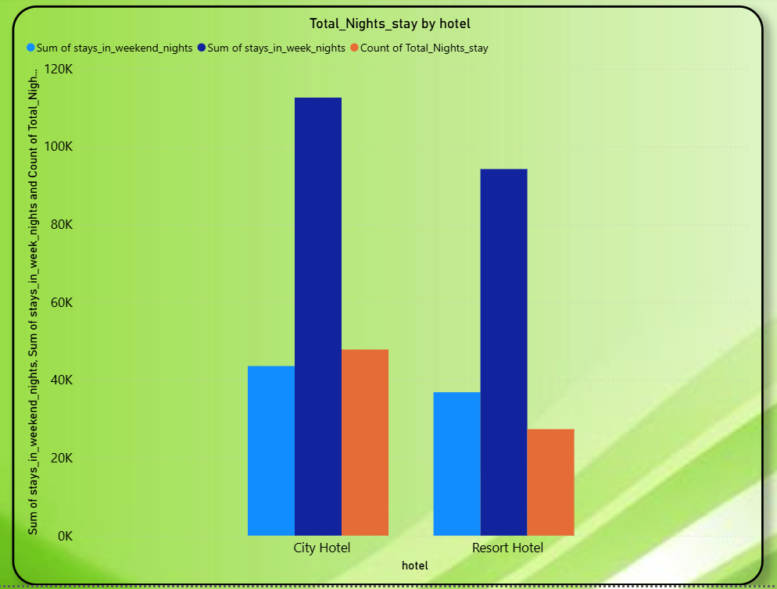
Additional Observations
Visual: Total Persons by Hotel (stacked bar chart showing adults, children, and babies).
City Hotel has higher stays on weekends.
Families (with children) prefer Resort Hotels for longer vacations.
175 countries indicate diverse international guests.

Slide 14
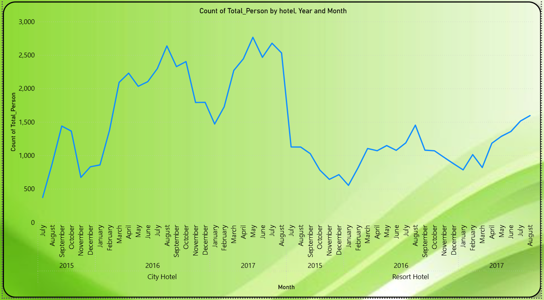
Month with Maximum Number of Guests
Visual : Line or chart by month showing total guests (from total_persons field).
Insight: The dashboard data shows clear seasonal variations — May Month had the highest bookings.
Conclusion: The hotel can increase pricing during peak months and run promotions in low-demand months.

Slide 15

Conclusion
City Hotels receive more bookings than Resort Hotels, but they also have a highor cancellation rate..
Most guests prefer the 'A' room type, so hotels should increase the number of these rooms to earn more revenue and meet customer demand.
Peak booking months are May to August, especially May. Hotels should plan resources during peak months and offer promotions or discounts during off-season months to maintain business.
There are fewer returning customers, so hotels should collect feedback, improve services, and introduce loyalty programs to increase repeat guest visits.

Slide 16



